Slide 1
From www.eclipse.org/osee to deployment
Tutorial (Part II: All in a days work)
Ryan Brooks
Donald Dunne
Roberto Escobar
Boeing
Mesa, AZ

Slide 2
Agenda
T. Rex with OSEE
  Products & Teams
  Variants
  Scenario Roles
  Project Workflows
Scenario: All in a days work
  Search Requirements
  Create Action
  Requirement Team Workflow
    Add Decision Review
    Change Implementation
  Code Team Workflow
    Add Tasks
  Test Team Workflow
    Privileged Edit
    Status
  Create Peer-To-Peer Review
  Add new Workflow

Slide 3
Project has been using OSEE for a couple of months now

Slide 4
Products & Teams
SAW – Surgical Assistant Workstation –
  Teams: Requirements, Code, Test, HW, SW Design
CIS – Dummy Project
  Teams: Requirements, Code, Test, SW Design
Facilities Team
IT Team
  Computers, Backups, Network
Tools Team
Website Team
Processes Team

Slide 5
Project Variants
Surgical Assistant Workstation - SAW
  Build 1
  Build 2
CIS Build 1 – Dummy Project
Work is performed in working branches which are then committed back into their respective parent branch
SAW Build 1
SAW Build 2
CIS Build 1

Slide 6
Roles
Project Manager
  Requirement
    Lead
    Developer
  Code
    Lead
    Developer
  Test
    Lead
    Developer

Slide 7
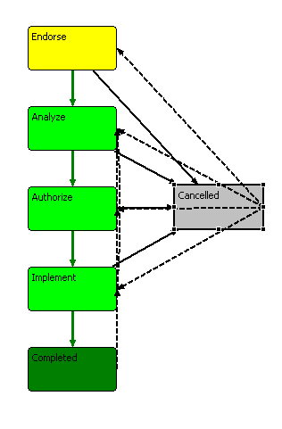
Workflow 1
Requirements
Code
Test
SW Design
Tools
Process
Notes:
Why move all action, issue, problem tracking to ATS?
1. Everyone has access to all data
2. As issue/problem is analyzed, other teams can be added to Action
3. Each team has it’s own independent workflow
4. Workflows can be simple or complex
5. One interface = Low cost of setup, deployment, training and admin

Slide 8
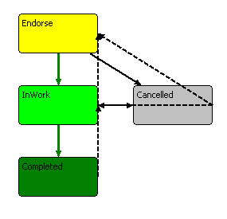
Workflow 2
Web
Facilities
Notes:
TODO - Whats CIS stand for?

Slide 9
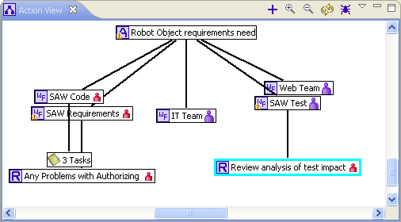
Scenario
Joe Smith finds a problem in a requirement impacting the following teams:
  Code
  Test
  Website
  IT
Reviews needed:
  Decision Review off Code Team Workflow
  Peer Review off Test Team Workflow
Perform tasks off Code Team Workflow
Notes:
Notes: You're welcome to follow along and perform the steps
- Limited time, so need to keep moving
- Will just explain some of the things going on versus showing due to time
- Will operate as more than one user, but will always say Joe Smith
- Will operate on single computer, this is multi-user/computer system with notifications

Slide 10
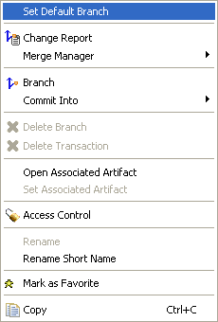
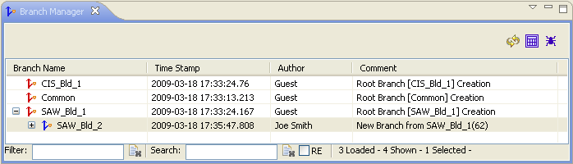
User searches for a requirement
Switch to the Define perspective
  Window->Open Perspective->Define
Set “SAW_Bld_2” as the default branch
  Click on the Branch Manager View
    If the view is not open
      Select Window->Show View->Branch Manager
  Right-Click on “SAW_Bld_2”
  Select “Set Default Branch”

Slide 11
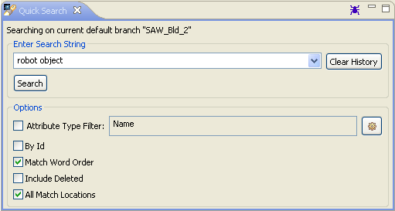
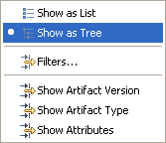
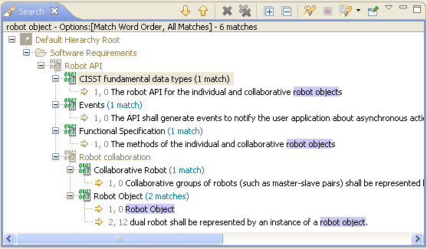
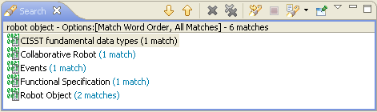
User searches for a requirement
Search for Item
  Click on the Quick Search View
  Enter “robot object” in the search string text box
  Check the “Match Word Order” option
  Check the “All Match Locations” option
  Click the search button
Search results as list or tree view with match locations
Select View

Slide 12
User explores the robot object requirement
From the search results view
  Right-Click on the “Robot Object” software
  requirement
  Select each of the following from the pop-up menu individually
    Reveal Artifact in Explorer
    Resource History
    Open With Artifact Editor
      Click on the attribute tab
      Click on the relation tab
    Open With MS Word Preview
    Sky Walker

Slide 13
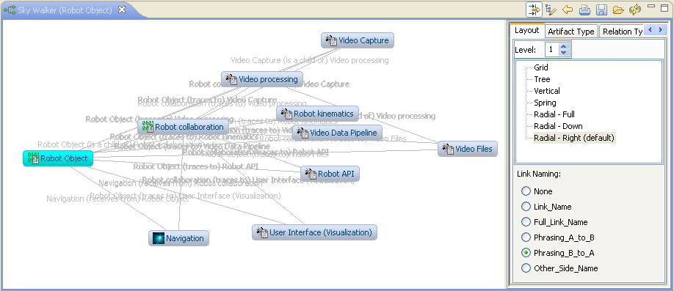
User explores the robot object requirement
Robot Object (software requirement) relates to other artifacts
Notes:
While looking through the robot object requirement, the user notices a problem.
An action will need to be written against it.

Slide 14

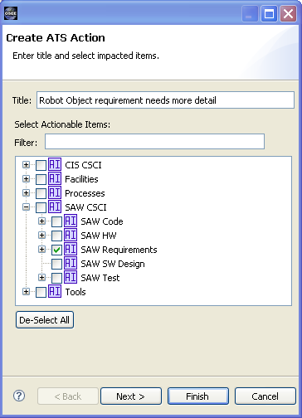
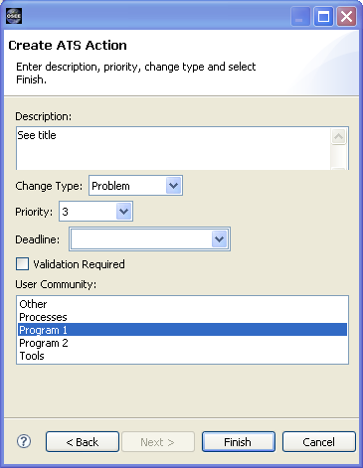
User creates an action
Create an action against the “Robot Object Requirement”
Switch to the ATS Perspective
  Window->Open Perspective->ATS
Click on the New Action icon in ATS Navigator
  Fill-in the Create ATS Action Dialog:
Next

Slide 15
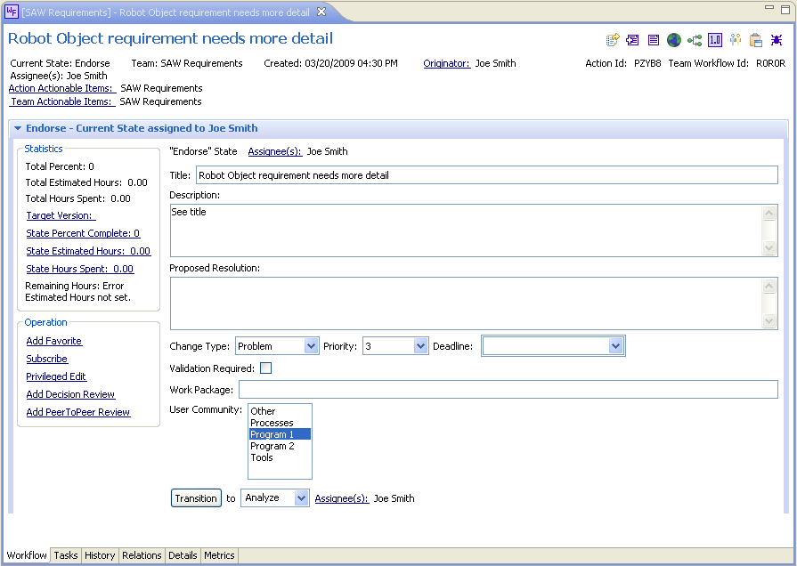
User creates an action
Automatically assigned to team lead
Notes:
Action created, assigned to Joe Smith (configured Lead for SAW Req Team)

Slide 16
Requirements lead approves requirement team workflow
Requirements Team Lead - Joe
  Endorses Action
Sets Target Version
  SAW Build 2 (the next version)
Changes priority to 2
Transitions state to “Analyze”
  This is where the lead would normally assign another user to complete the work
  NOTE: We will not change the assigned user for the demo

Slide 17
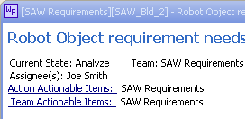
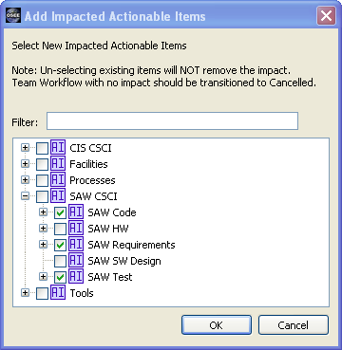
Requirements developer analyzes requirement team workflow
Requirements Developer - Joe
  Analyzes Action
Sets proposed resolution to “Fix It”
Change will impact code and test
Add code and test workflows
  Select “Actionable Items” hyperlink
  Add SAW Code
  Add SAW Test
Action View shows new workflows
Email has been sent to leads
Transitions to Authorize
Notes:
NOTE: Can be reassigned or configured to be auto-assign

Slide 18
Requirements lead begins to authorize the requirement team workflow
Requirements Team Lead - Joe
  Authorizes Action
Sets Work Package to A324324A
Team lead needs concurrence from Kay (The Manager)
  A decision review is needed

Slide 19
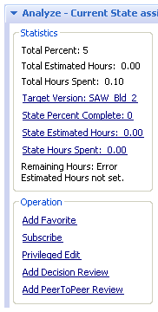
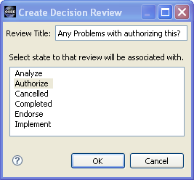
Requirements lead creates a decision review
Create Decision Review
  Select Add Decision Review
  Fill-in the Create Decision review Dialog:

Slide 20
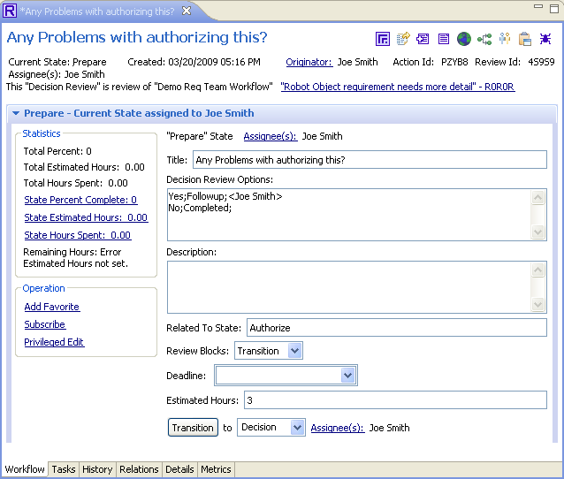
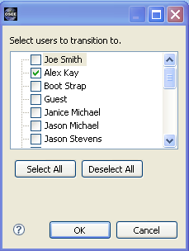
Requirements lead prepares the decision review
Prepare Review
  Set Review Blocks to Transition
  Set Estimated Hours to 3
  Assign to Alex Kay
  Transition the review

Slide 21
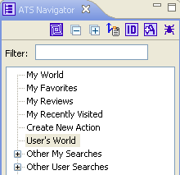
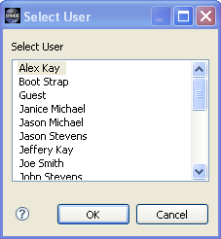
Manager approves the change
Alex Kay checks his assigned work
Runs “My World”
  Select “User’s World”
  Select Alex Kay
From Alex Kay’s “User’s World”
  Select the “Decision Review”
  Kay decides Yes
  Transitions the Review to Completed

Slide 22
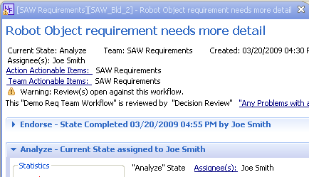
Requirements lead completes authorization
Sets Estimated Hours to 2.5
Transition to Implement
Notice that before Alex Kay had completed the decision review, Joe was not able to transition to the next state

Slide 23
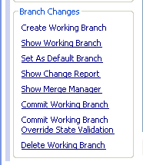
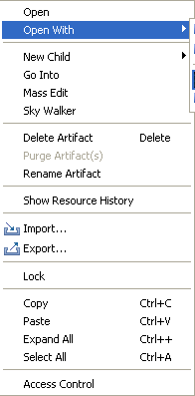

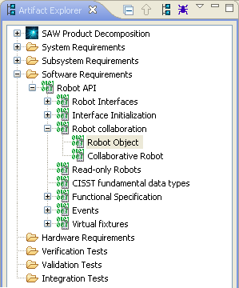
Requirements developer implements a change
From the Implement State
  Select “Create Working Branch”
  Set the working branch as the default branch
Using Artifact Explorer, navigate to the “Robot Object” software requirement
Right-Click on “Robot Object”
From the pop-up menu, select “Open With”
Select “Artifact Editor”

Slide 24
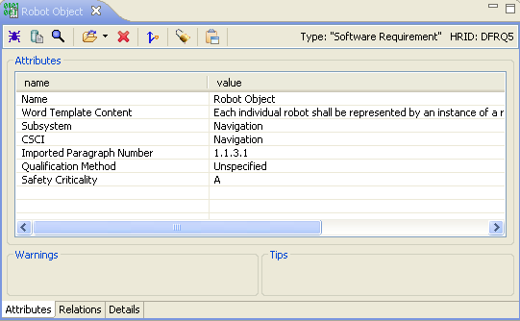
Requirements developer implements a change
Select the attributes tab
Change Qualification Method to Inspection
Save by clicking
File->Save

Slide 25


Requirements developer implements a change
From the “Artifact Editor’s” toolbar
  Click on “Open With” down arrow
  Select MS Word Edit
    NOTE: If you don't have MS Word, just watch
Insert into word document
  “Need more information here.”
Save document and close
  “Artifact Editor’s” Word Template Content Attribute should update accordingly

Slide 26
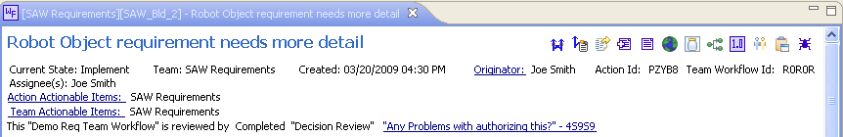
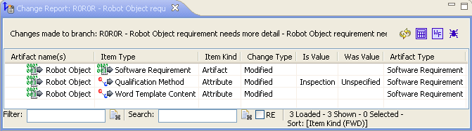
Requirements developer implements a change
Switch to the Workflow Editor
Select “Show Change Report” from the tool bar item

Slide 27
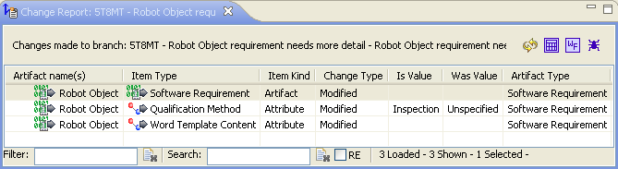
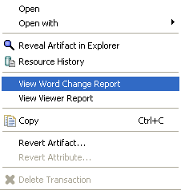
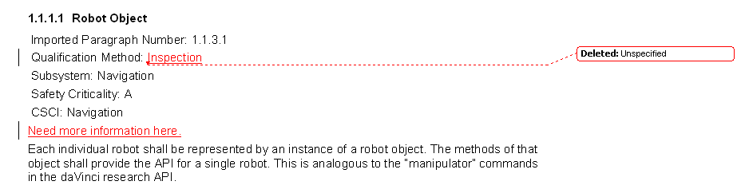
Requirements developer implements a change
From the Change Report View
Right-click on the “Robot Object” software requirement
Select “View Word Change Report” from the pop-up menu

Slide 28
Requirements developer implements a change
Select "Commit Working Branch“ to apply changes to the parent branch “SAW_Bld_2”
Transition to Complete

Slide 29
Code lead endorses code team workflow
Sets Work Package to A234532
Transitions to Analyze
Notes:
Remind that this was created in the analyze action by the requirements lead

Slide 30


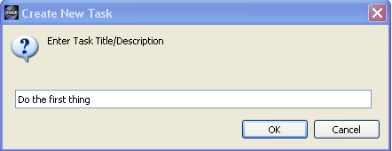
Code developer analyzes team workflow
Sets Estimated Hours to 10
Analysis Requires Tasks
  Switch to the Tasks Page by clicking on the Task Tab
  Add a Task by clicking on the “New Task” tool bar item
  In the “Create New Task” dialog enter “Do the first thing”
  Click “OK” to close the dialog

Slide 31
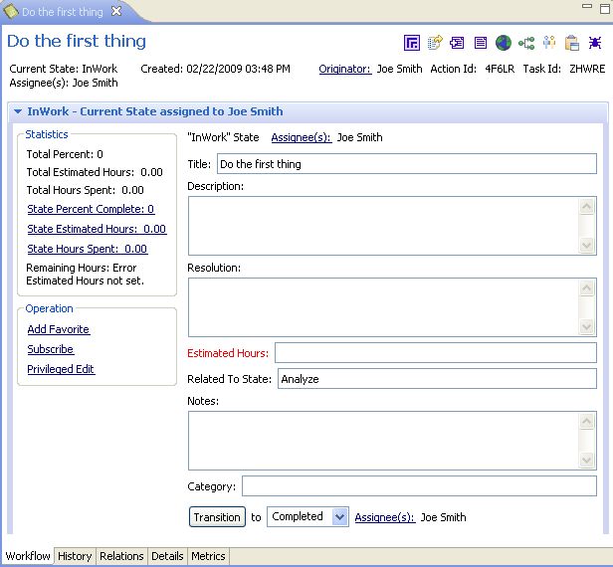
Code developer analyzes team workflow
Double-click on the new task to open the Task Editor
Click on Assignee(s) to assign a different user
Close Task Editor
Add two more tasks
Transition code team workflow to Authorize

Slide 32
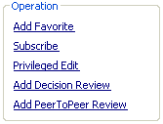
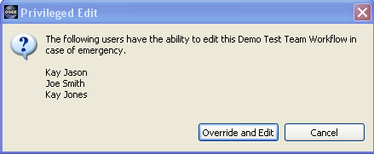
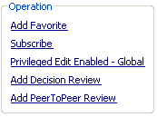
Test lead endorses test team workflow
Test Lead – Joe
  Estimates the work
Kay Jones is not in today and estimates are due...
Joe will need to get edit privileges to transition the workflow
Click on “Privileged Edit” to display the “Privileged Edit” dialog
Click on “Override and Edit”
Transition To Analyze
Set Estimated Hours to “25”
Notes:
Remind that this was created in the analyze action by the requirements lead

Slide 33
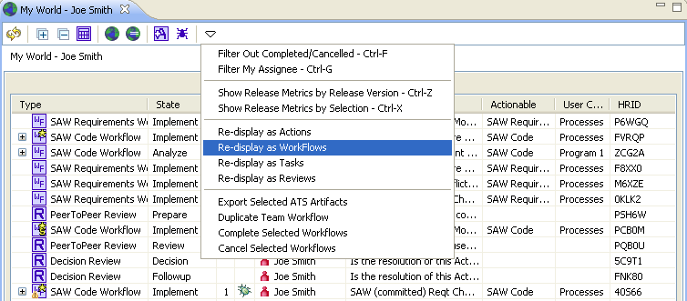
Manager wants status
Manager – Alex Kay
  Needs status report
Select “World”
Redisplay as workflows

Slide 34
Manager wants status
Click on “Metrics Tab” to open the Metrics Page
Set “Estimated Completion Date” to 2 Days from the current date
Kay won't make it (slacker); Joe will

Slide 35
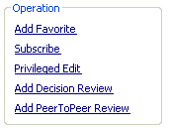
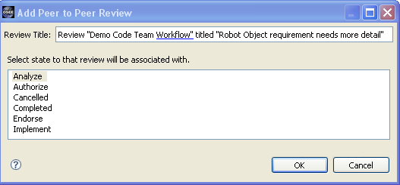
Code developer adds a peer review
Code Developer – Joe
  Realizes he needs a peer review for Analysis
Add Peer-To-Peer Review
  Click on the “Add PeerToPeer Review” hyperlink
  In the “Add Peer to Peer Review” dialog, select “Analyze” state
  Click “Ok”

Slide 36
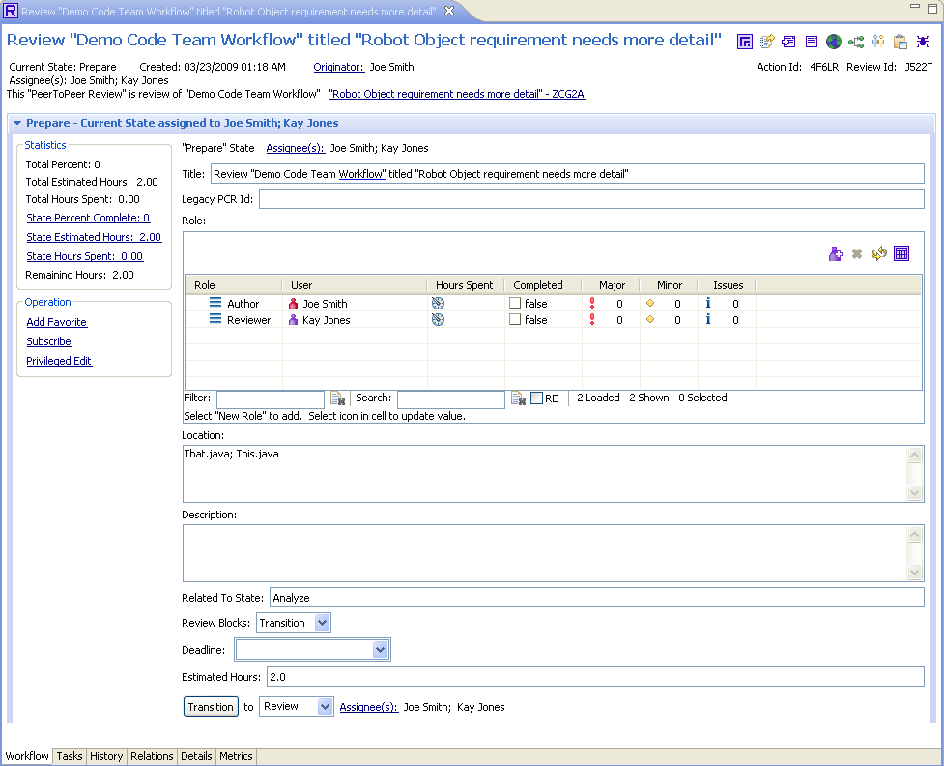
Code developer adds a peer review
Click on the New Role tool item to add 2 reviewers
Set one of the roles to “Author” and the other to “Reviewer”
  Edit the “Role” field so by clicking on the field while pressing the “ALT” key
Set Location to “That.java; This.java”
Set Blocking to “Transition”
Set Estimated Hours to “2”
Transition to Review
ALT+Click to edit field

Slide 37
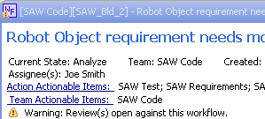
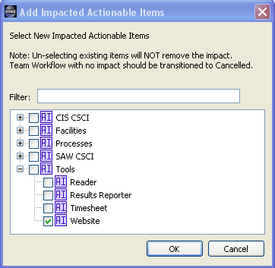
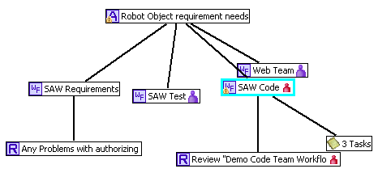
Code developer creates a tool team workflow
Code Developer – Joe
  Realizes the change will affect the Tools Team
Select the “Action Actionable Items” hyperlink from the SAW Code Workflow
Select “Website” from the “Add Impacted Actionable Items” dialog
Workflows are created for the Website Team

Slide 38
BREAK

